Slide 1

The pursuit problem
Zahra Akbari
Lambda circle
Lambda circle

Slide 2
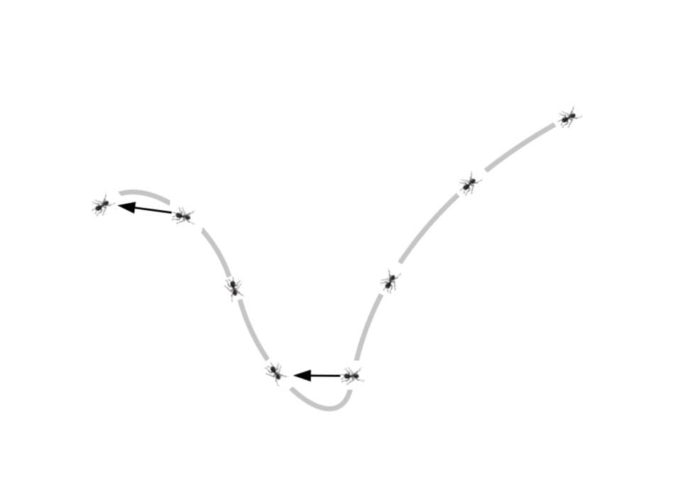
A curve of pursuit is a curve constructed by analogy to having a point or points representing pursuers and pursuees; the curve of pursuit is the curve traced by the pursuers.

Slide 3
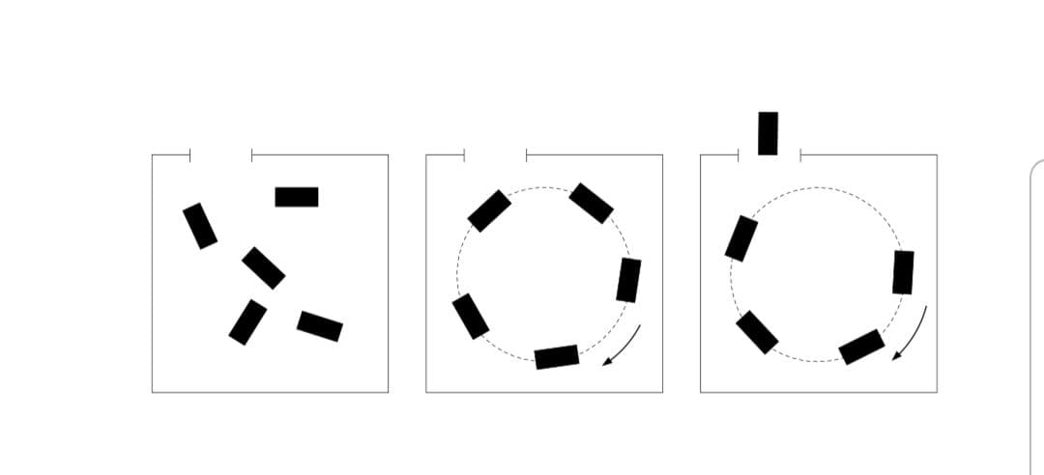
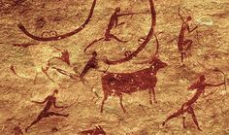

Slide 4
1.All objects are chasing one preferred object. 2.All object are in pursuit of each other in a cyclic way.

Slide 5
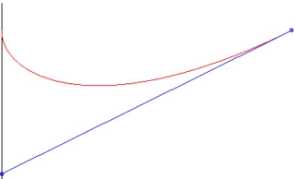
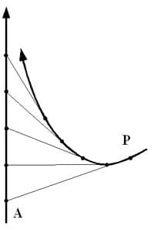
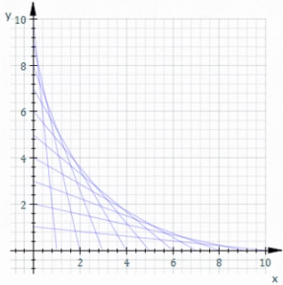

Slide 6
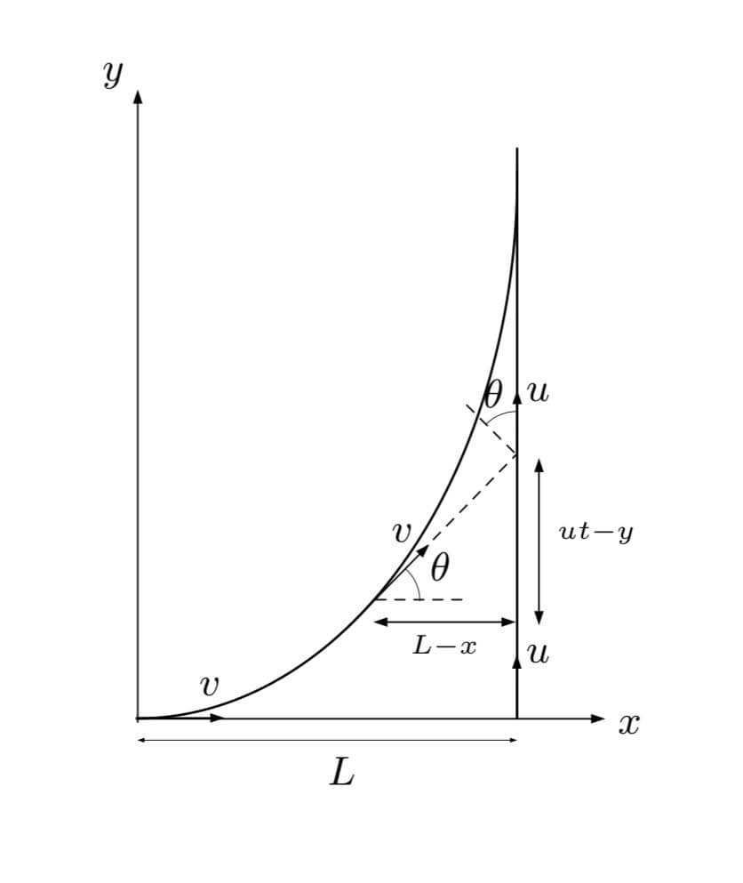


The persuee is moving on a straight line
R(t)

Slide 7


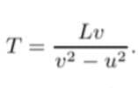

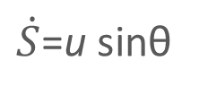
$\dot{S}$=u sinθ

Slide 8
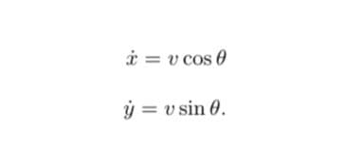









Slide 9
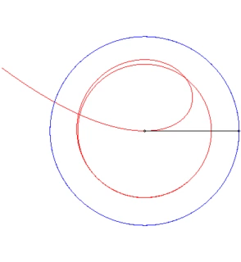
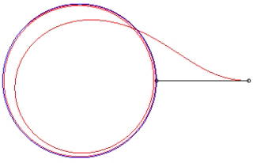
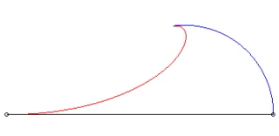
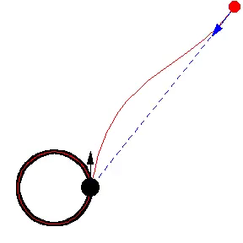
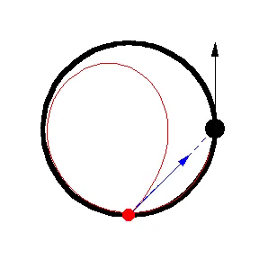

Slide 10
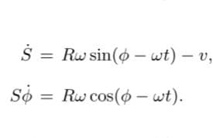


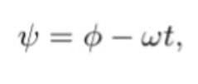
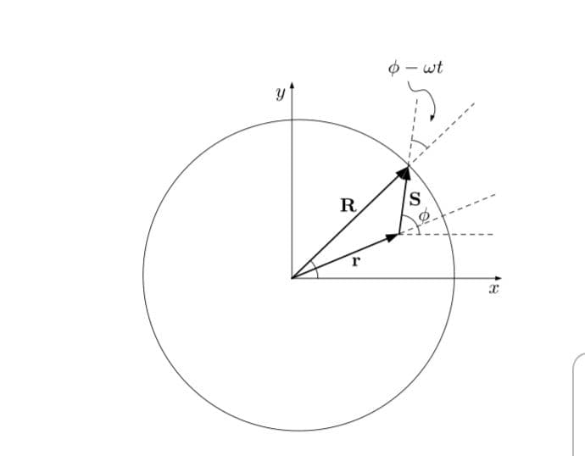


The pursue is moving on a circle

Slide 11

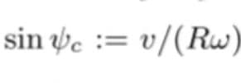
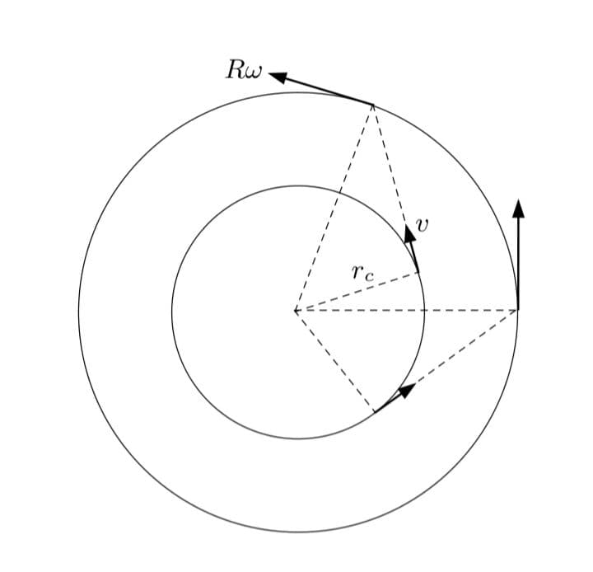




Slide 12
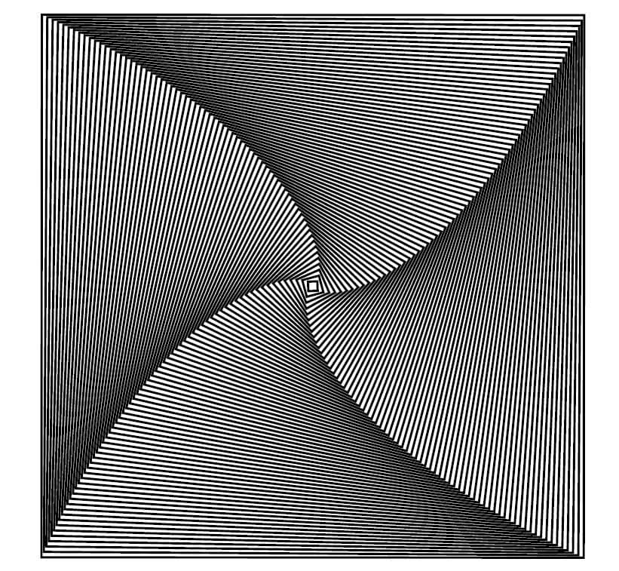
Cyclic pursuit N-bug problem

Slide 13
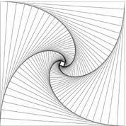
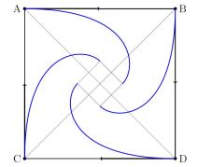

Slide 14
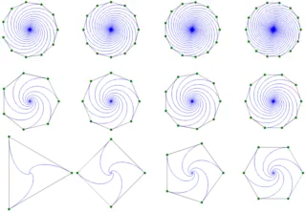

Slide 15
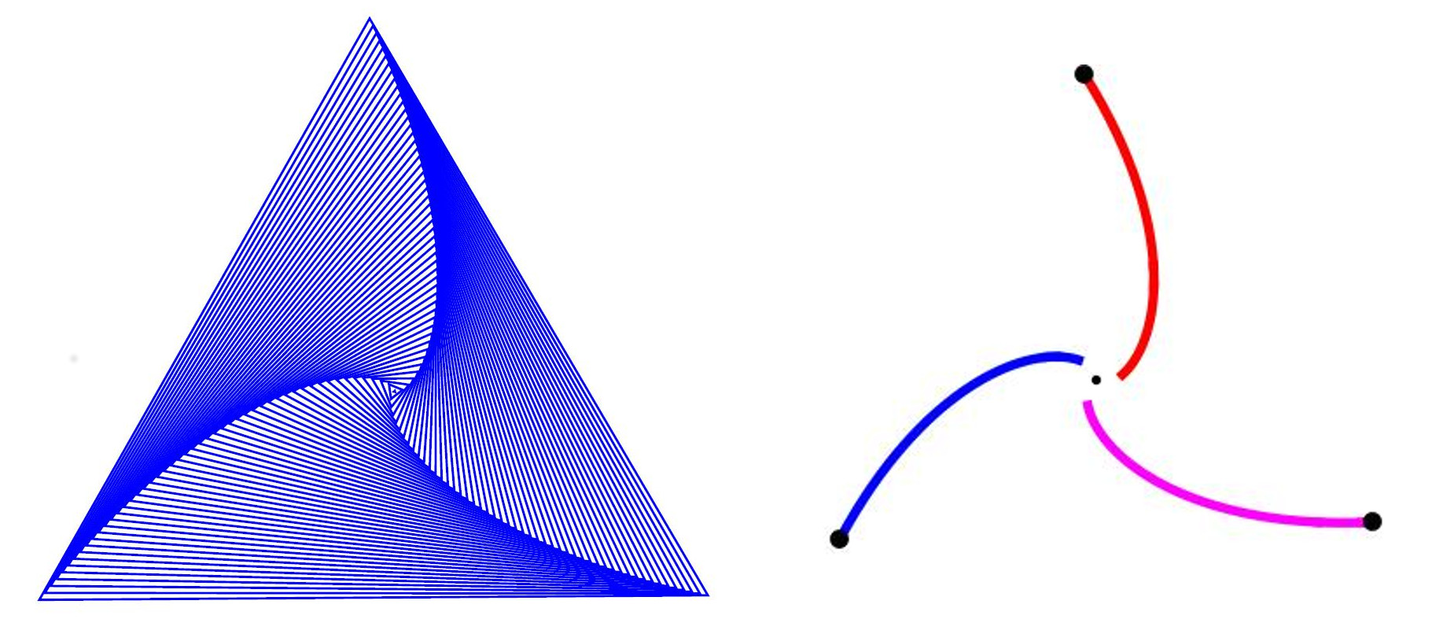

Slide 16
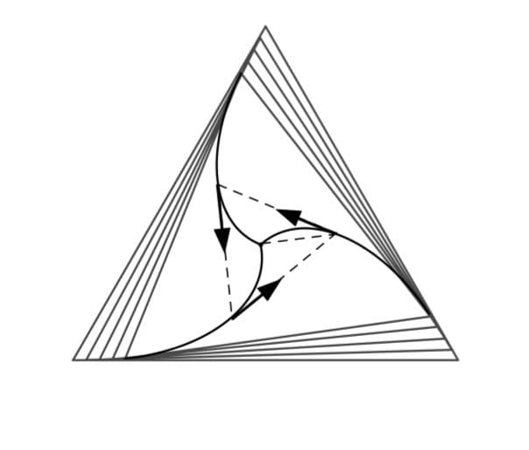
Special case 3 objects

Slide 17


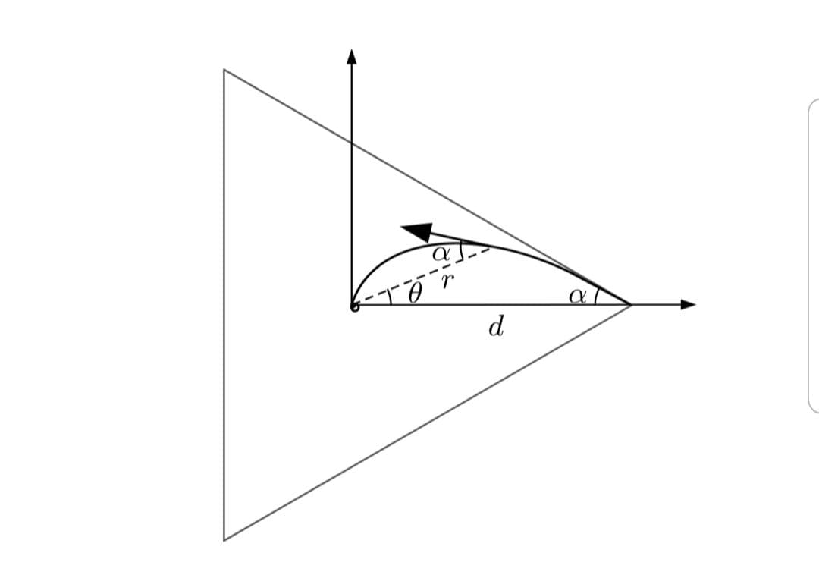



Slide 18

N objects

Slide 19
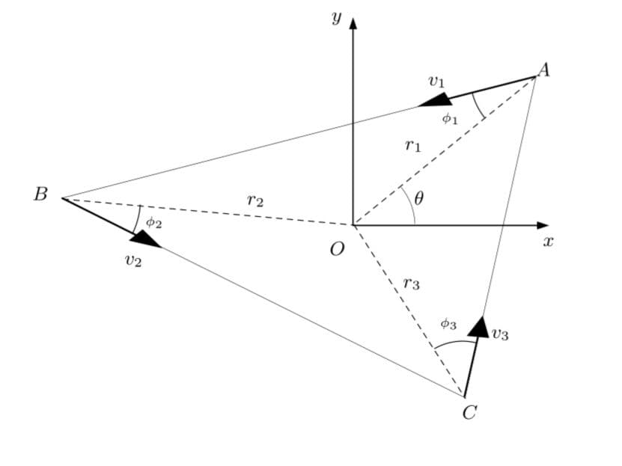

Slide 20
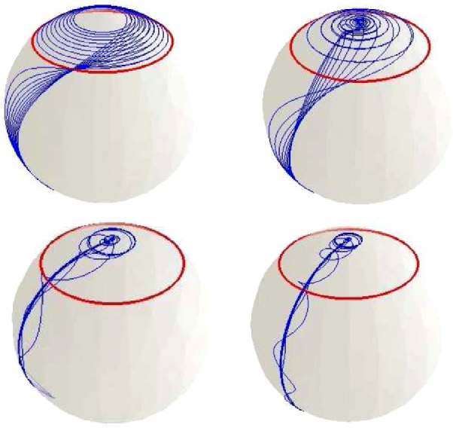
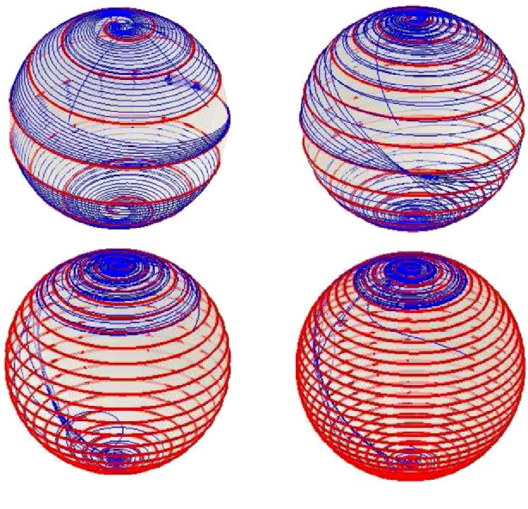

Slide 21

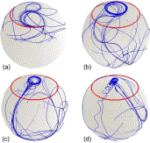


Slide 22
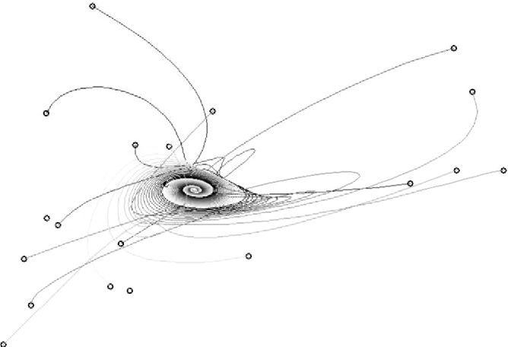
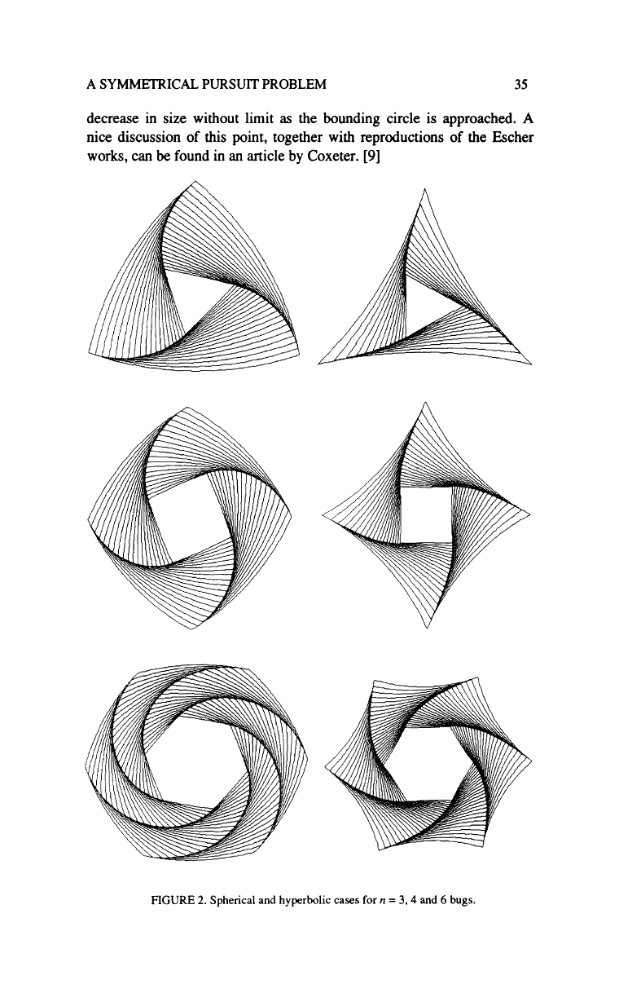
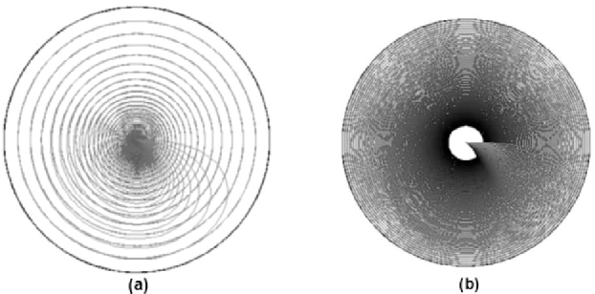

Slide 23


Slide 24
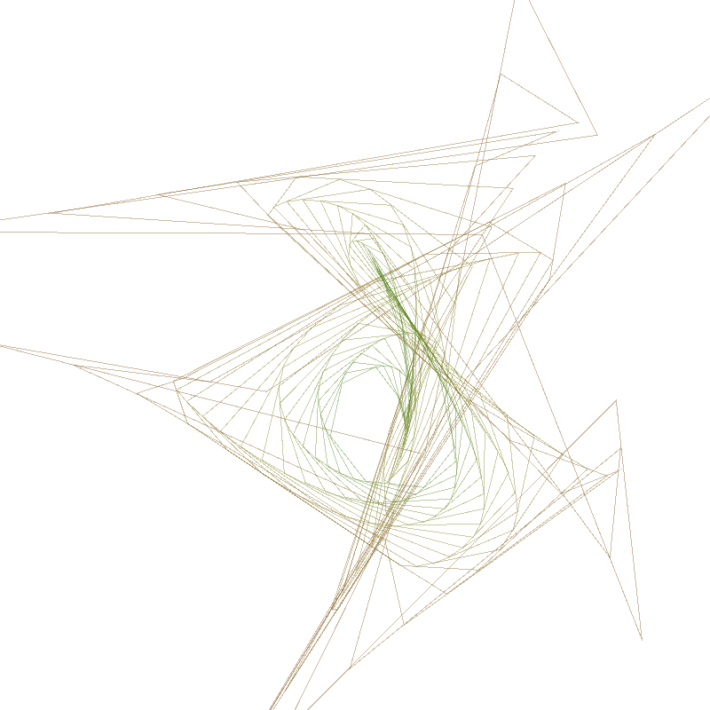
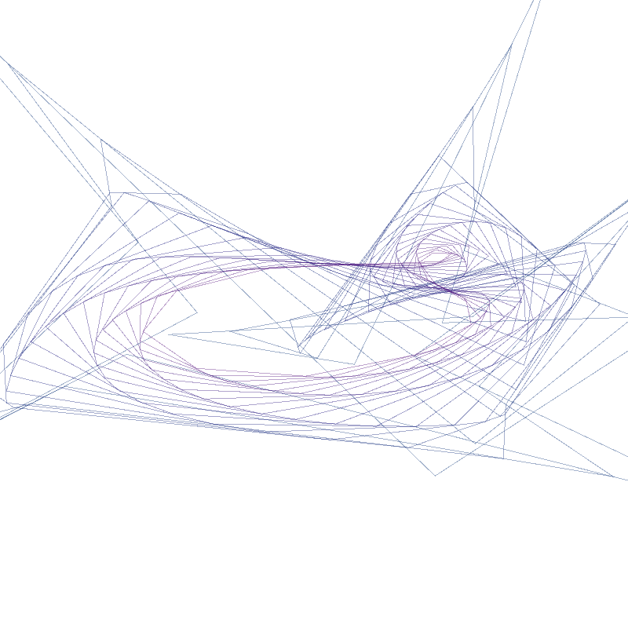

Slide 25
Further studies at:
M. S. Klamkin, and D. J. Newman. “Cyclic Pursuit or ‘The Three Bugs Problems.’” The American Mathematical Monthly, vol. 78, no. 6, 1971, pp. 631–639. JSTOR, www.jstor.org/stable/2316570. Accessed 12 Nov. 2020.
http://www.gammajournal.ir/pdf/gamma_no_14_pp_59-70.pdf
Paul J. Nahin - Chases and Escapes_ The Mathematics of Pursuit and Evasion
Aravind, P. (1994). A symmetrical pursuit problem on the sphere and the hyperbolic plane. The Mathematical Gazette, 78(481), 30-36. doi:10.2307/3619428
https://faculty.missouri.edu/~casazzap/pdf/teach/bug.pdf
https://github.com/arnav-t/pursuit-wallpapers
https://github.com/samm81/PursuitCurve

